Slide 1
Lesson 2nd​
Part 1
Introduction in Microsoft Word

Slide 2



Contents – Lesson 2
Move within the document.
  Change cursor position.

Slide 3
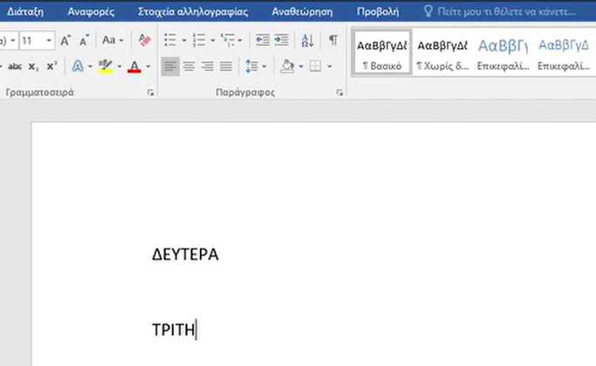
Contents – Lesson 2
Line change

Slide 4
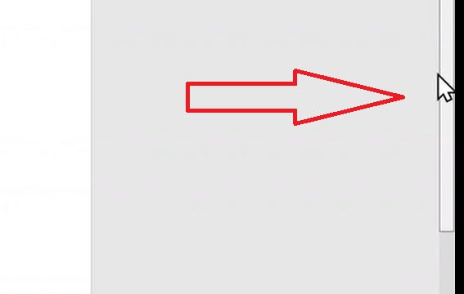
Contents – Lesson 2
Move to the top and bottom of the document using the scroll bar .

Slide 5
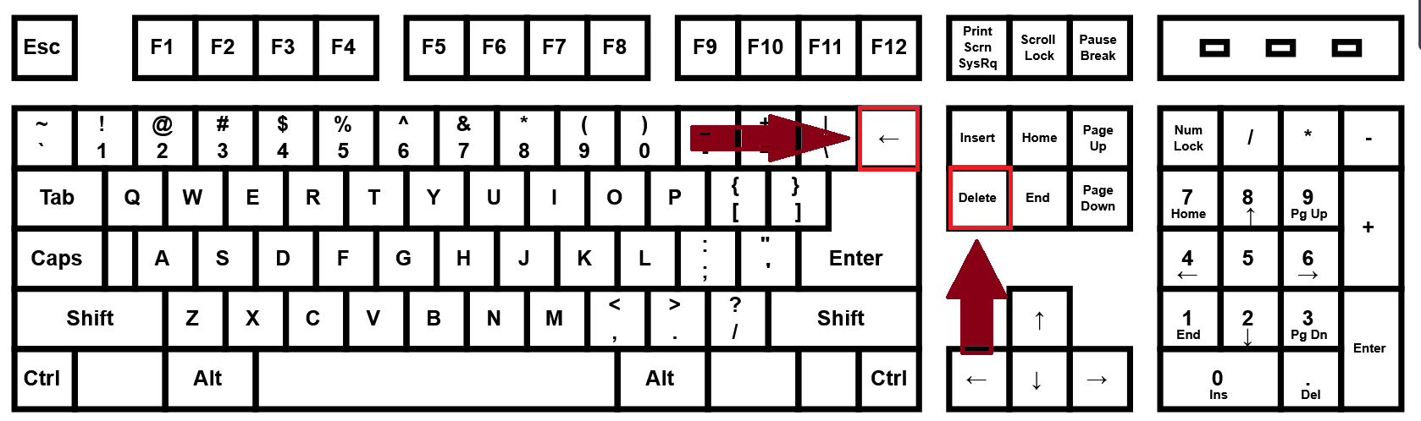
Contents – Lesson 2
Deleting characters with the Delete keys and Backspace

